Slide 1
Evolution of international oil market since 1928 till nowadays: whether we are moving towards unipolar oil world?
Prof. Dr. Andrey A.Konoplyanik,
Adviser to Director General, Gazprom export LLC,
Professor, Chair “International Oil & Gas Business”,
Russian State Gubkin Oil & Gas University
andrey@konoplyanik.ru,
a.konoplynik@gazpromexport.com,
www.konoplyanik.ru
Presentation – Open Lecture at the
5th Anniversary of “International Semester” Programme,
Saint Petersburg State University of Economics (FINEC),
Saint-Petersburg, 13.12.2013

Slide 2
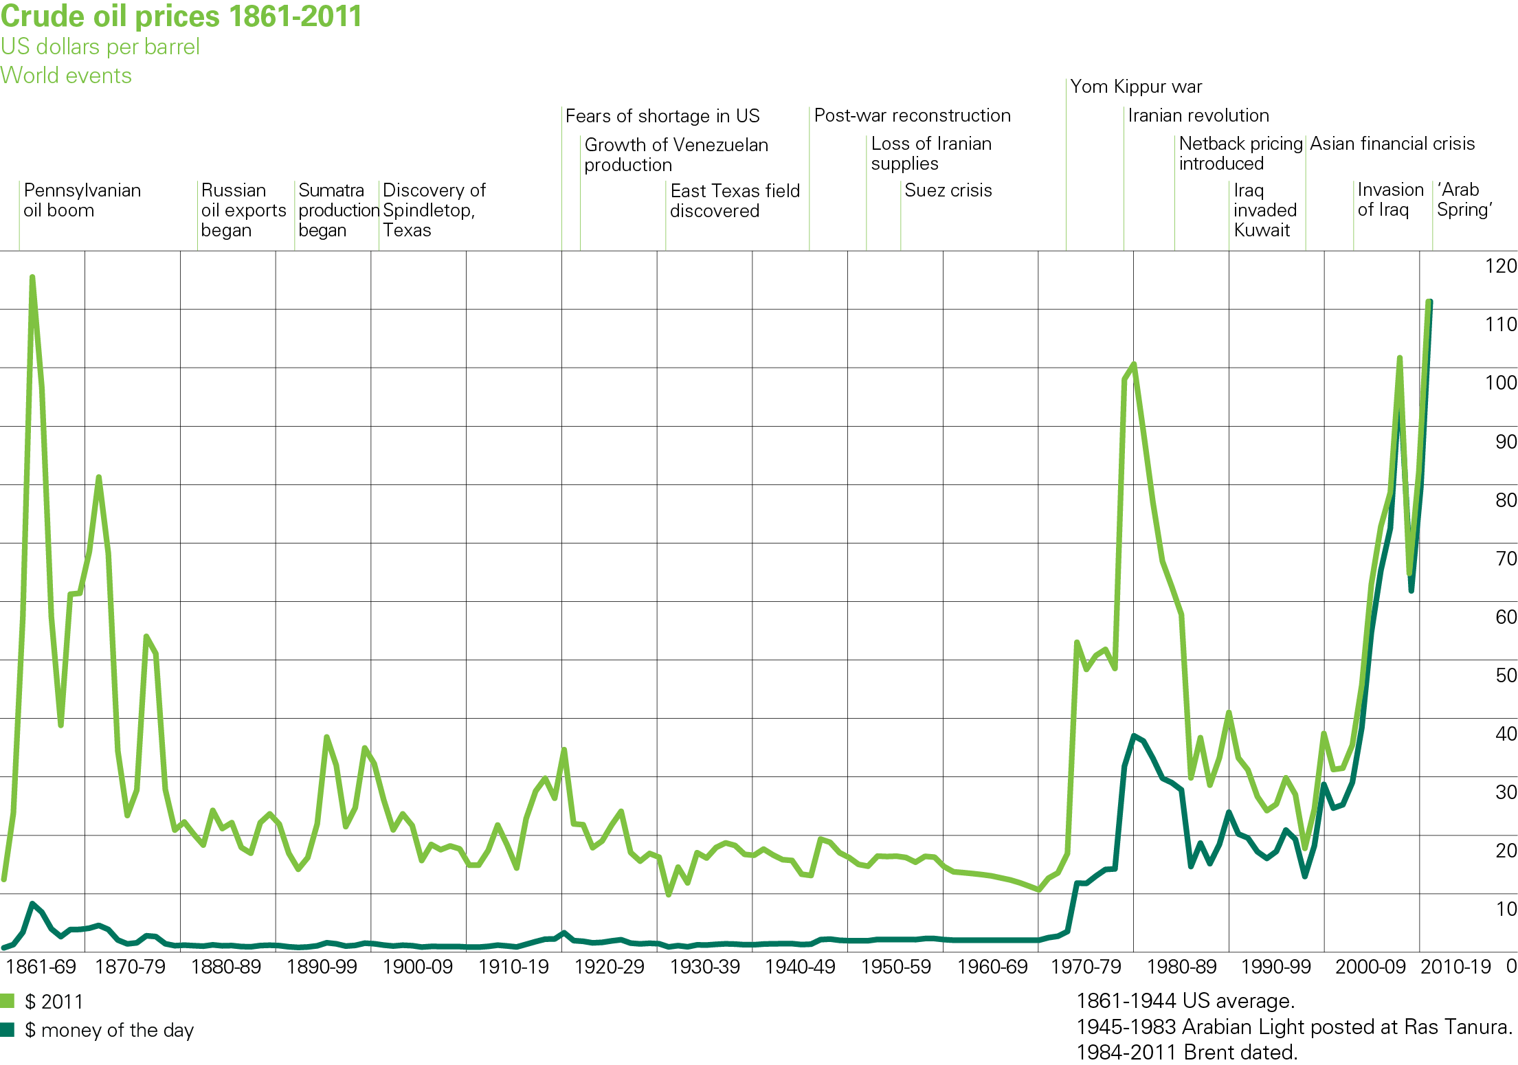
Chart of crude oil prices since 1861
Crude oil historical price peaks
Achnaccarry Agreement 1928

Slide 3
Table of contents
Energy markets: general trends & evolution curves, contractual structures & pricing mechanisms (author’s economic interpretation of Hubbert’s curves)
International oil: five stages of global oil market development since 1928
2000-ies: new stage in oil pricing
Role of some market players (Saudi Arabia, USA, Russia)

Slide 4
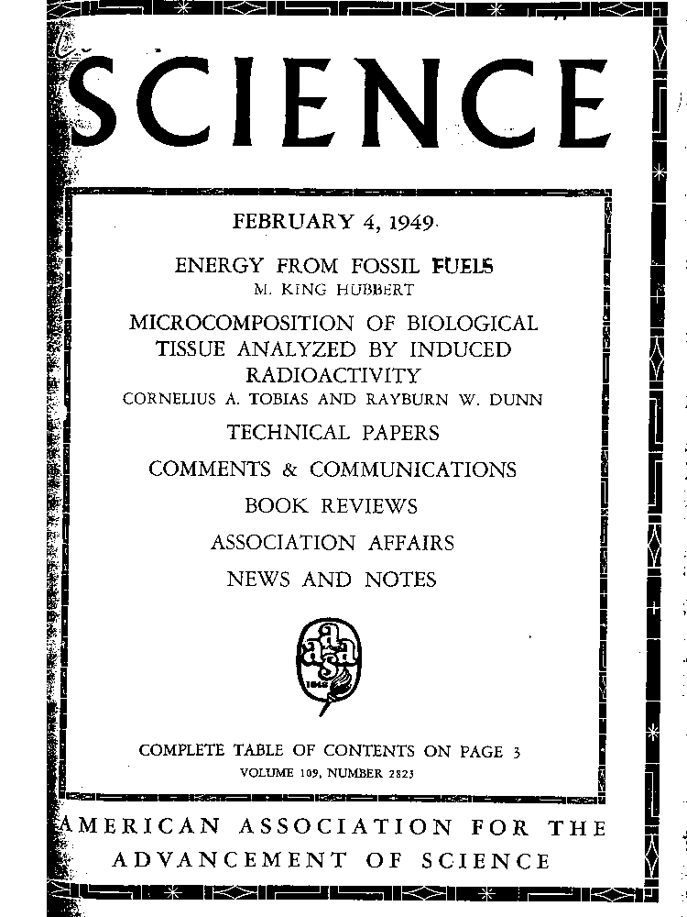
Marion King Hubbert & Hubbert’s curve(s)
«Hubbert’s curve» is an illustration of the theory that production profile of non-renewable energy resource within time-frame is close to normal distribution curve. Was first published by M.K.Hubbert, then geophysicist of Shell Oil Company, in “Energy from Fossil Fuels” article in “Science” magazine on February 4th, 1949. Using his model, M.K.Hubbert had predicted that US oil production will peak about 1970 what has happened later in practice, though he has predicted that world oil production will peak around 2000 (with then available resource base) which has not happened yet. This made Hubbert’s theory very popular and since then being implemented very broadly, sometimes rather straightforwardly. «Hubbert’s curve» is broadly used in scientific and pseudoscientific circles to predict limitation of resource use and their depletion. This curve is the main component of “peak oil theory” which heat up concerns as if soon depletion of [existing] oil resources (reserves).
From my view, “Hubbert’s peak” is a “sliding target” that constantly moves in upward-right direction

Slide 5
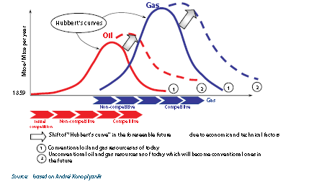
Oil & Gas Hubbert’s curves: upward-right supply peaks steady movements
Deep horizons, deep offshore, Arctic, shale gas, CBM, CSM,
CMM, tight gas, gas hydrates, etc…
Deep horizons, deep offshore, Arctic, heavy oil, shale oil, tar sands, GTL, CTL, XTL, etc…
Legend: CBM = coalbed methane (from unmined rock), CSM = coalseam methane (from active coal mines), CMM = coalmine methane (from abandoned coal mines), GTL = gas-to-liquids, CTL = coal-to-liquids, XTL = biomass to liquids
We will not reach Hubbert’s peaks in O&G at least within TWO INVESTMENT CYCLES (first - based on currently commercialized technologies, second – based on those yet not commercialized technologies that are currently at R&D stage)

Slide 6
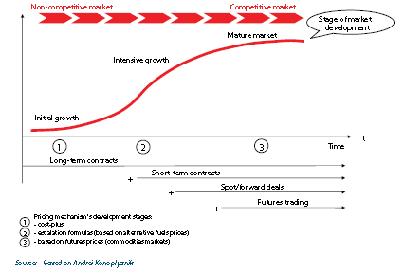
Evolution of oil & gas markets: correlation of development stages, contractual structures, pricing mechanisms on the left (upward-growing) wing of Hubbert’s curve
Paper energy (oil, gas) market(s)
Physical energy (oil, gas) market(s)
Through two investment cycles we will leave within left (upward-growing) wing of Hubbert’s O&G curves
In addition – not instead to !!! => increasing competitive choice for market players through value chain & dynamic balancing

Slide 7
Evolution of oil & gas markets: correlation of development stages, contractual structures, pricing mechanisms on the left (upward-growing) wing of Hubbert’s curve (2)
Paper energy (oil, gas) market(s)
Physical energy (oil, gas) market(s)
Long-term contracts + cost-plus pricing => lower investment price (physical market)
… plus Futures contracts + futures pricing (exchange) => trade price (paper market)
… plus Long/medium/short-term contracts + replacement value pricing => upper investment price (physical market)
… plus Spot contracts + spot pricing (OTC) => trade price (physical market)
The principle: in addition to – not instead of!!!

Slide 8
Evolution of oil market: volumes of trade vs. volumes of physical supplies
Long-term contracts
Spot deals
Forward deals (2) (*)
Short-term contracts
Forward deals (1) (*)
Futures & options
?
Volume of trade corresponds to volume of supplies
Volume of trade exceeds volume of supplies => OTC market (subsequent re-sales of non-unified commercial batches – “daisy chains”)
Volume of trade multiply exceeds volume of supplies => liquid marketplaces/exchanges (multidirectional re-sales of unified supply liabilities)
Increasing liquidity, but also growing market instability =>
good for traders/speculators, but is short-term & deprives project financing
Markets of physical goods (of “physical” oil)
Financial markets (of “paper” oil)
(*) (1) within the limits of coverage by accumulated volumes of stocks, (2) beyond such limits

Slide 9
Table of contents
Energy markets: general trends & evolution curves, contractual structures & pricing mechanisms (author’s economic interpretation of Hubbert’s curves)
International oil: five stages of global oil market development since 1928
2000-ies: new stage in oil pricing
Role of some market players (Saudi Arabia, USA, Russia)

Slide 10
Five periods of global oil market development and their major characteristics – periods 1 & 2
Periods | Characteristics of the period
1928-1947 (first period) | - non-competitive physical oil market, - dominance of International Oil Cartel (7 companies), - “one-base pricing” (cost-plus), - transfer pricing/prices within vertical integration and long-term traditional concessions,
1947-1969/1973 (second period) | - non-competitive physical oil market, - dominance of International Oil Cartel (7 companies), - ” two-base pricing” (cost-plus in crude, net-back replacement value in petroleum products), - transfer pricing/prices within vertical integration and long-term traditional & modernized concessions & PSAs, - 1969-1973 – transition period from monopoly of 7 companies to monopoly of 13 states;

Slide 11
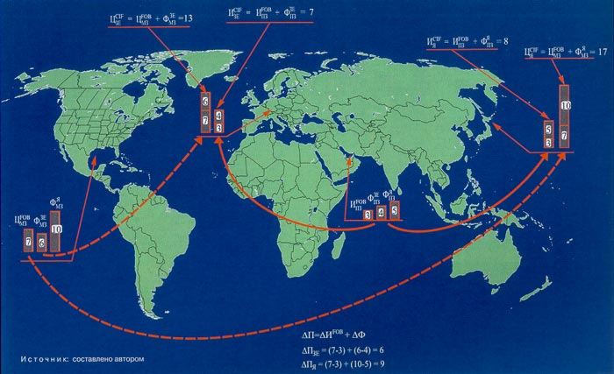
Mechanism of “single base pricing” at international oil market in 1928-1947 (notional figures)

Slide 12
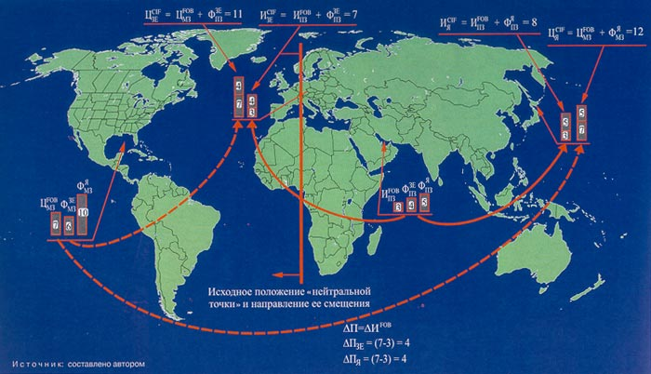
Mechanism of “double base pricing” at international oil market in 1947-1971 (notional figures)

Slide 13
Five periods of global oil market development and their major characteristics – period 3
Period | Characteristics of the period
1973-1985/1986 (third period) | - non-competitive physical oil market, - dominance of OPEC (cartel of 13 states), - contractual and spot pricing/prices, - official selling prices (cost-plus/net-forward) within long/medium/short-term contractual structures mostly linked to spot quotations, - fundamentals as key pricing factors (supply-demand balance on physical oil), - key players – participants of physical oil market, - 1985-1986 – transition period from net-forward to net-back crude pricing based first on net-back from petroleum products basket price at the importer’s market, afterwards – to oil price futures quotations on key petroleum exchanges/marketplaces;

Slide 14
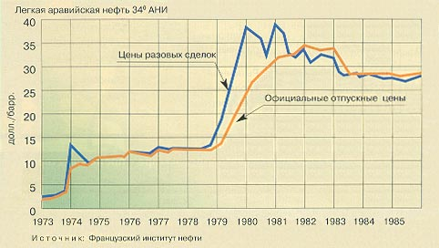
Dominant role of spot prices in international oil trade as a basis for OPEC OSS formation during 1970-ies - 1980-ies – period 3

Slide 15
Five periods of global oil market development and their major characteristics – period 4
Period | Characteristics of the period
1986-mid.2000-ies (approx. post-2004) (fourth period) | - competitive combination of mature physical plus growing paper oil markets, - commoditization of the oil market, - pricing established at oil marketplaces mostly driven by oil hedgers, - net-back from futures oil quotations, - formation of the global paper oil market and its institutes based on the institutes of financial markets (instruments and institutions imported to paper oil market by financial managers from financial markets), - transition from physical to paper market predetermined unstable, relatively low and volatile prices which has led to underinvestment of global oil industry which created material preconditions for later growth of costs and prices, - hedgers as key players (participants at both physical and paper oil market), - fundamentals still as key pricing factors;

Slide 16
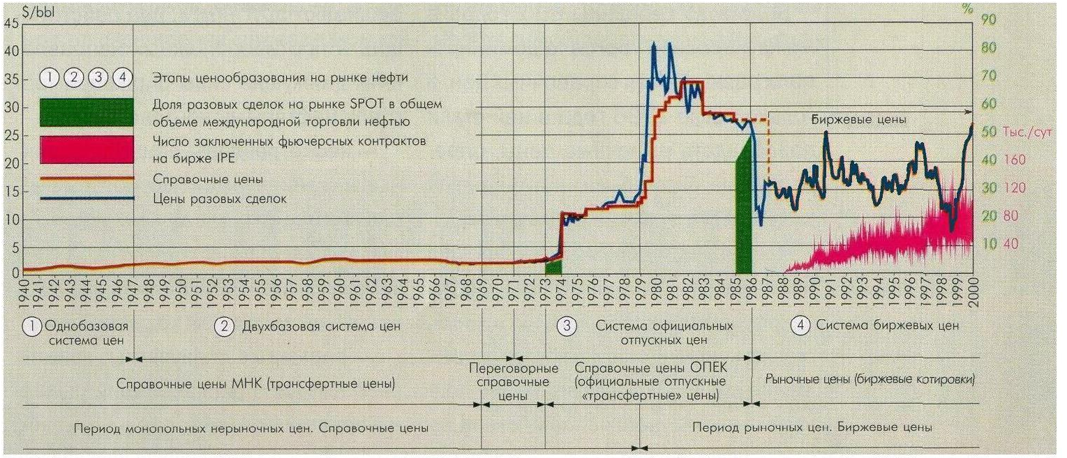
Evolution of pricing systems in international oil trade – periods 1-4
Futures prices dominate oil market, but NOT used by oil companies as benchmarks for project financing any more => ‘oil price’ is NOT a signal for long-term oil development

Slide 17
Five periods of global oil market development and their major characteristics – period 5
Period | Characteristics of the period
Since mid-2000-ies (approx. post-2004) (fifth period) | - competitive combination of both physical and paper mature oil markets, - further movement from commoditization to financialization of oil market - paper market dominates in volumes of trade, - global institutes of paper oil market are formed which enable paper oil market to work in 7X24 regime, - globalization, IT-technologies, broad spectrum of financial products converted crude oil into global financial asset available (accessible) to every category of professional and non-professional investors (effect of financial “vacuum sweeper”), - paper oil market is an insignificant segment of global financial market, - key players are non-oil speculators which have been bulling the market and have manipulated it (investment banks and their affiliated oil traders), - pricing established outside of oil marketplaces (at non-oil financial markets) mostly by non-oil speculators, - net-back from futures oil quotations & oil financial derivatives, - key pricing factors are mostly financial: supply-demand balance for oil-related financial derivatives within short time-horizon.

Slide 18
Evolution of pricing mechanisms at international oil market
Periods, who establish the price | Pricing formula for physical supplies
(1) 1928-1947: International Oil Cartel (one-base pricing) | Net forward (cost-plus): P _{CIF} = = P _{FOB} (Mex.Gulf) + Freight fict. (Mex.Gulf)
(2) 1947-1969/73: International Oil Cartel (two-base pricing) | To the West of neutral point: Net forward (cost-plus): P _{CIF} = = P _{FOB} (Mex.Gulf) + Freight fict. (Mex.Gulf) To the East of neutral point: Net forward (cost-plus): P _{CIF} = = P _{FOB} (Mex.Gulf) + Freight real (Pers.Gulf)
(3) 1973-1986: OPEC | Net forward (spot-plus): P _{CIF} = = P _{FOB} (OPEC OSP) + Freight real (OPEC)
(4) 1986-mid-2000’s: oil exchange 1 (hedgers => oil speculators) | Net back: P _{FOB} = P _{CIF}/exchange – Freight real P_{CIF} = Exchange quotations (oil paper market)
(5) Mid-2000’s & beyond: oil exchange 2 (NON-oil speculators) | Net back: P _{FOB} = P _{CIF}/exchange – Freight real P_{CIF} = Exchange quotations (NON-oil non- commodities paper markets)

Slide 19
Legend to Figure
P _{CIF} (net forward) - price CIF (at importer end) calculated as cost-plus;
P _{FOB} (Mex.Gulf) - price FOB (at supplier end) in the Mexican Gulf area;
Freight fict. (Mex.Gulf) – freight rates for fictitious oil deliveries from Mexican Gulf area to importers;
Freight real (Mex.Gulf), Freight real (Pers.Gulf) – freight rates for real oil deliveries from Mexican and Persian Gulf areas;
P _{FOB} (OPEC OSP) – OPEC official selling prices FOB;
Freight real (OPEC) – freight rates for real oil deliveries from OPEC member-states to importers;
P _{FOB} (netback) - price FOB, calculated as netback price (price CIF less transportations costs);
Ц _{CIF} (exchange) - price CIF as exchange quotations (at consumer end);
Freight real – freight rates for real oil deliveries to importers from production areas.

Slide 20
Table of contents
Energy markets: general trends & evolution curves, contractual structures & pricing mechanisms (author’s economic interpretation of Hubbert’s curves)
International oil: five stages of global oil market development since 1928
2000-ies: new stage in oil pricing
Role of some market players (Saudi Arabia, USA, Russia)

Slide 21
2000-ies: new stage in oil pricing => key changes
Supply-side: Underinvestment of the 1990-ies => cost increase since early 2000-ies + decrease in spare production capacities
Demand-side: China, India, etc. – accelerated demand growth (since 2003) + accumulation of strategic petroleum reserves in developed countries (USA), China
Institutional-side: Abolition of Glass-Stegal Act (1999) + US Commodity Futures Modernization Act (CFMA) (Dec. 2000)
Operational-side: Evolution of commodities (exchange, futures) trade:
  Internet + IT technologies => electronic marketplaces/trading floors (IPE=>ICE=> end of voice floor trading) => robotization of electronic trading => increase in amount of traders + ease of market entry
  Decrease of USD exchange rate (increase of oil import => increase in trade & budget deficit) => appearance of index oil funds => expansion of possibilities for financial investments in oil-related instruments + hedging against fall of USD rate
  Globalization of financial operations => ease of horizontal financial flows from/to financial (non-oil) sectors into/from paper oil market
  Ease of financial investments into oil market (derivatives on derivatives) => “Belgian dentist” as key private (non-institutional) financial investor at the paper oil market
Oil-linked derivatives of index funds become the new class of financial assets aimed at compensating, inter alia, from fall of USD exchange rate
Switch of oil pricing from physical market (supply/demand of physical oil) – to paper market (supply/demand of oil-related financial derivatives)

Slide 22
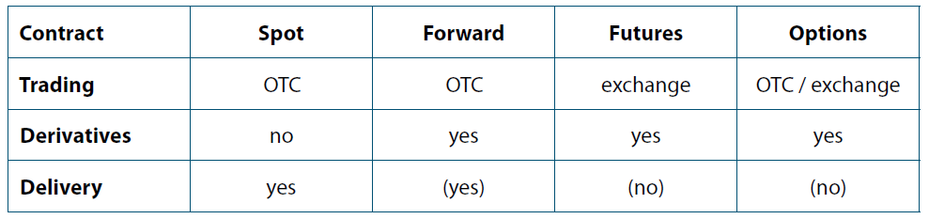
Characteristics of spot, forward, futures, options deals
Why such changes became possible? There is NO obligation for physical supplies under paper oil contracts (financial derivatives) !!!
Source: Putting a PRICE on Energy: International Pricing Mechanisms for Oil & Gas. – ECS, 2007, p. 81

Slide 23
Paper oil market: key players
  Hedgers (since 1980’s):
  Usually producers/consumers of physical goods using futures (financial) markets to mitigate price risks
  NYMEX: 1978 – LFO, 1983 – WTI
  IPE: 1988 – Brent => today crude of reference of appr. 2/3 of internationally traded oil
Oil speculators (since 1990’s):
  Players aimed at earning their profit from price fluctuations without physical deliveries/purchases – working mostly within paper oil market (no major horizontal capital flows to other non-oil financial markets)
Non-oil speculators (since mid-2000’s):
  The same – players aimed at pure monetary results, but working within the whole spectrum of global financial markets => enter paper oil market from non-oil & non-commodities paper markets

Slide 24
Evolution of oil futures markets
For 2 decades (mid-80-ies/mid-00-ies) oil futures markets were playground for physical market players:
  Energy companies, major users of petroleum products (airline & maritime transport, utilities)
  They wanted to hedge price risk in their own business (physical deliveries/purchases)
Since mid-00-ies these markets started to attract growing number of financial market traders:
  Banks, investment/hedge/pension funds,
  They are completely foreign to physical oil market

Slide 25
Correlation of scales of oil, commodities and financial & monetary markets (order of figures)
Prior to 2008 = 1%,
2008 = 2%
(R.Jones, IEA, at Global Commodities Forum, UNCTAD, Geneva, 31.01.2011)
Financial & monetary markets = 100+
Commodities market = 10+
R.Jones: 500-1000
(31.01.2011)
“Paper” oil market = 3+
I.Kopytin: 10+
(IMEMO RAS, 22.06.2011)
“Physical” oil
market = 1

Slide 26
Role of non-oil speculators (global “financial investors”) in forming “price bubble” at the global oil market in 2007-2008 (principal scheme)
Inflow of liquidity to the oil market – searching for incremental rate of return
Outflow of liquidity from the oil market as result of the starting crisis of liquidity and world financial crisis
Non-oil speculators (financial investors from other than oil segments of the global financial market)
Value of oil trade operations
Oil speculators
Oil producers/consumers/traders
t

Slide 27
Table of contents
Energy markets: general trends & evolution curves, contractual structures & pricing mechanisms (author’s economic interpretation of Hubbert’s curves)
International oil: five stages of global oil market development since 1928
2000-ies: new stage in oil pricing
Role of some market players (Saudi Arabia, USA, Russia)

Slide 28
Damages and repairs of global oil futures/commodities markets: US role
US past damaging role:
  Abolition of Glass-Stegal Law (1999)
  Commodities Futures Modernization Act (CFMA) (Dec. 2000)
  CFMA left commodity transactions largely outside the reach of CFTC => left companies with minimal regulatory obligations from too risky operations
US expected future repairing role:
  Wall Street Transparency and Accountability Act (Dodd-Frank Act) (enacted by US Congress on July 21, 2010; to come into effect on July 14, 2011 =>?)
  Dodd-Frank effectively replaces CFMA & makes it illegal for producers to execute trades outside forthcoming & more restrictive CFTC rules

Slide 29
Saudi Arabia and USA – two countries really influencing today global oil market
Saudi Arabia (physical oil market):
  Level of production +
  Level of spare capacities (historically swing producer) +
  So-called “fair oil price” (propagated internationally) = de facto fiscal price of Saudi Arabia non-deficit budget
USA (paper oil market):
  US role in global economy & global financial markets +
  Value of financial (incl. oil) derivatives under US control (4US banks vs 95%) (IMEMO RAS) +
  Oil pricing in US dollars (both physical oil & financial oil derivatives) +
  USD emission controlled by US FRS +
  Recycling of petrodollars (1970/80-ies: in goods, nowadays – in financial services)
  Result: US today as oil importer spend less (at physical oil market) than it earns in oil-related financial transactions (at paper oil market) (IMEMO RAS)

Slide 30
USA at global oil market: what happens next?
USA (increasing role at physical oil market):
  Decreasing crude import
  Increasing exports of petroleum products
  From shale gas to shale oil revolution (same technologies within same institutional environment to the market with higher monetization prospects)
  US: from gas importer to LNG exporter => further on to oil exporter?
Whether we are moving towards unipolar oil world within double-segment global oil market?

Slide 31
USSR/Russia at the global oil market (1)
Yesterday: USSR at the “physical oil” market stages (stages 2-3):
  USSR oil production level did not play significant role in defining state of the international oil market => USSR was a «price-taker», not a «price-maker»:
    Geography – far away from world consumption centers,
    High costs level,
    No reserve capacities, but in case of their appearance – no economically justified possibilities to arbitrage them for price-making reasons

Slide 32
USSR/Russia at the global oil market (2)
Today: Russia at the “paper oil” market stages (stages 4-5):
  Russian oil production level does not play significant role in defining state of the international oil market => Russia is a «price-taker», not a «price-maker», it is not (and can’t be) an “energy superpower”:
    The same factors as in the USSR (worsening geography / geology, high costs, no reserve capacities), plus yet underdevelopment of domestic financial market / system:
      Russia de facto not represented at the oil financial derivatives markets (at the level of statistical discrepancy?) => whether it can play noticeable role there if/when domestic financial market underdeveloped ? => matter of time
      Yet absence of domestic oil exchange market (local monopolies at physical market + underdeveloped financial market + absence of “quality bank” for oil + …) => matter of time
      Sequence of actions: first – financial system, then oil exchange trading (historical experience from global oil market development)
    Key: investment climate & cost reduction through value chain

Slide 33
Thank you for your attention! www.konoplyanik.ru andrey@konoplyanik.ru a.konoplyanik@gazpromexport.com

Slide 34
Oil price balancing Russian budget (with & without “corruption tax”) - & “fair oil price”
Electoral years in Russia
“Fair oil price” after Egypt & Libya, etc. events (2011): 100-120 USD/bbl
Buklemishev
Orlova
Al-Naimi (2009+) => SPb Economic Forum (2009): “fair oil price” = 60-80 USD/bbl
Oil price, USD/bbl
2000
2005
2010
2013
- Average annual Urals oil price (according to Russian Ministry for Economic De3velopment)
- Arithmetic mean price of Buklemishev & Orlova less “corruption tax”
Source: Konoplyanik 2011a (figure created by the author based on the data from presentations of Buklemishev O.V. & Orlova N.V. at the conference “20 years after USSR. What’s next?” (Moscow, 09.06.2011) who have kindly provided their data to the author)

